Slide 1
ECE Presentation Template 1A
Open ECE logo with short UBC signature and with option of using logo identities in title and closing slides only

Slide 2
ECE Template #1A - Recommended Use
This template is designed to allow for the ECE open logo and short UBC signature logo identities to appear on all slides – or just title and closing slides only.
To use this template, click “save as” and create your new document.
All new slides types can be sourced from the Slide Master. The slides that follow have been created to provide some guidelines on the style options available and instructions for use. You can re-purpose them or delete them once you have saved them as your new presentation.
The last two slides allow you to cut and paste the ECE and UBC logo identities for use in a customized presentation, if necessary.

Slide 3
Title option 1
Title and closing slide
with image

Slide 4
How to place a new image in title option 1
This template includes a placeholder image for the option of a title slide with an image (see preceding slide)
To replace the image provided with one of your own, go to the Slide Master view and click on the very top of the current image. Clicking anywhere else on the image won’t work as you will activate the logo pane instead.
Click delete to remove the current image, then paste in your own.
Size your image appropriately to fit the slide. Click the “send to back” button to allow type and the logo rays to appear over top of the image.
Adjust the type colour and position on the slide as necessary to have it read on top of the image you selected.

Slide 5
Title option 2
Title and closing slide with ECE blue background with no image

Slide 6
Title option 3
Title and closing slide without image

Slide 7
Title and content layout – option 1
This format contains logo identities.
It should be used in instances where use of the ECE and UBC identity is desired throughout your presentation.

Slide 8
Title and content layout – option 2
This format contains no logo identities.
It should be used in instances where use of the ECE identity is only desired in opening and closing slides.

Slide 9
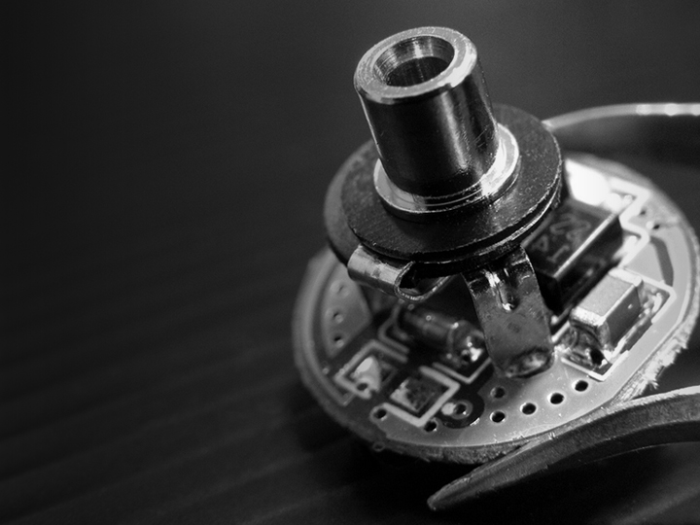

This is an example of how a Research Group logo can be inserted with this template

Slide 10

Combined ECE and UBC logo images to cut and paste for customization
Use this slide to cut and copy logos for your own presentation design.
It is recommended the ECE logo always be used in conjunction with the UBC identity in the proportions shown.
Click on the bottom of this slide to cut the ece and UBC logos together in their current left-right configuration. Then “send to back” in the master slides in your presentation.

Slide 11

Separate ECE and UBC logo images to cut and paste for customization
When you need to use ECE and UBC logos in a different configuration than the left-right orientation shown below, you can cut and paste them separately by clicking on the individual images on this page.

