Slide 1
ECE Presentation Template 2B
Closed ECE logo in footer bar, with footer bar in title and closing slides only

Slide 2
ECE Template #2B - Recommended Use
This template is designed for presentations utilizing the ECE closed logo and UBC logo in a footer bar that appears in title and closing slides only. The options of either a dark-blue or blue-grey footer are available (these are the official UBC colours).
For the same footer bar treatment, but with the logos on all slides, see template 2B.
To use this template, click “save as” and create your new document.
All new slide types can be sourced from the Slide Master. The slides that follow have been created to provide some guidelines on the style options available and instructions for use. You can re-purpose or delete them once you have saved them as your new presentation.

Slide 3
Title option 1
Title and closing slide with image and dark-blue footer

Slide 4
Title option 2
Title and closing slide with image and grey-blue footer

Slide 5
How to place a new image in title options 1 or 2
This template includes a placeholder image for the option of a title slide with an image (see the preceding two slides).
To replace the image with one of your own, go to the Slide Master view and find the title slide with the footer colour you want.
Click on the temporary image and delete it, then paste in your image.
Size your image appropriately to fit the slide. Click the “send to back” button to allow type to appear over top of the image.
Adjust the type colour and position on the slide as necessary to have it read on top of the image you selected.

Slide 6
Title option 3
Title and closing slide with dark-blue footer and no image

Slide 7
Title option 4
Title and closing slide with blue-grey footer and no image

Slide 8
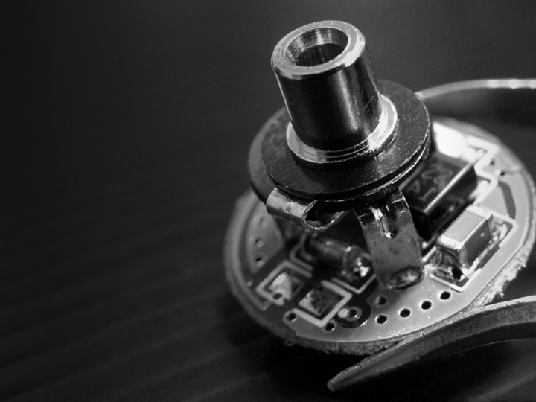
This is an example of the inclusion of a Research Group logo – reversed out in white

Slide 9
Title and content layout
Bullet copy goes here.
No logo footer bar will appear, as shown.

